Slide 1
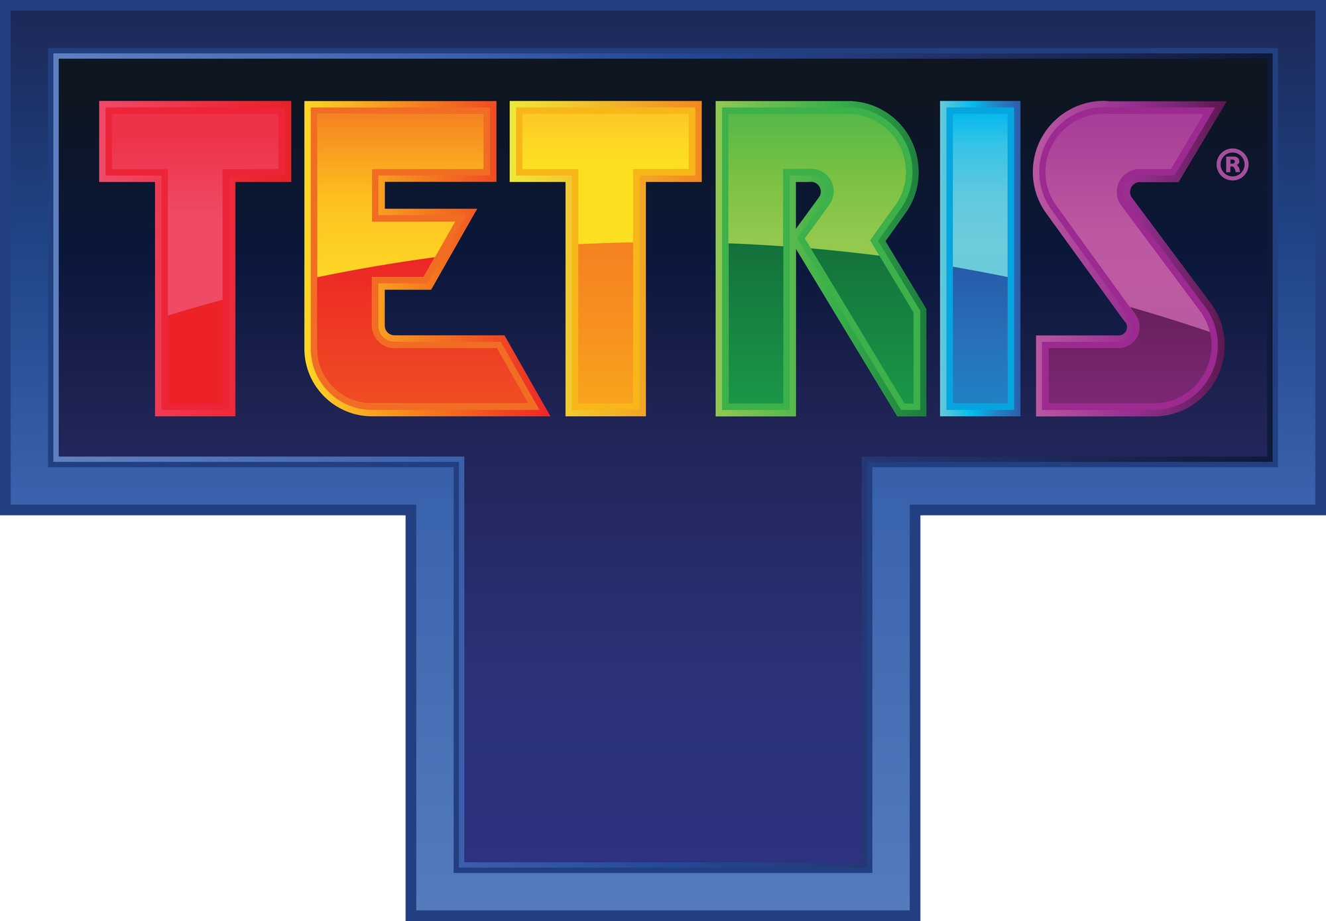
Deep Reinforcement
Learning

Slide 2
Team Members
Emilio Kiryakos
Dev Patel
Markus Perez
Michael Klimek
Christopher Bejar
Notes:
Chris

Slide 3
Project Objective
Primary Objective
Create base agent that can reach 10,000 pts in under 30,000 episodes
Use different reward functions, benchmarking and comparing the reward function designs for Tetris
Secondary Objective
Create an environment for Tetris using either Tetris Gymnasium or open-source Tetris programs and collect data
Lay groundwork for future offline reinforcement learning research on Tetris
Notes:
Chris

Slide 4
Refresher on
Reinforcement
Learning
Notes:
Chris

Slide 5
Reinforcement Learning
Reinforcement Learning
Focuses on the study of intelligent agent behavior with the goal of reward maximization
Rewards are scores accumulated from a reward function that rates different behavior
Steps
Create Agent & Rewards for Agent
Let Agent use the environment and learn from its Rewards
Fine tune to get desired results
Notes:
Chris

Slide 6
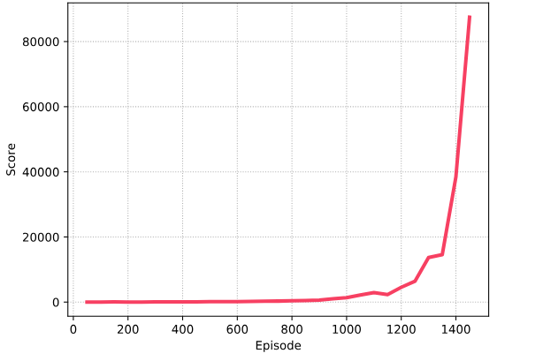
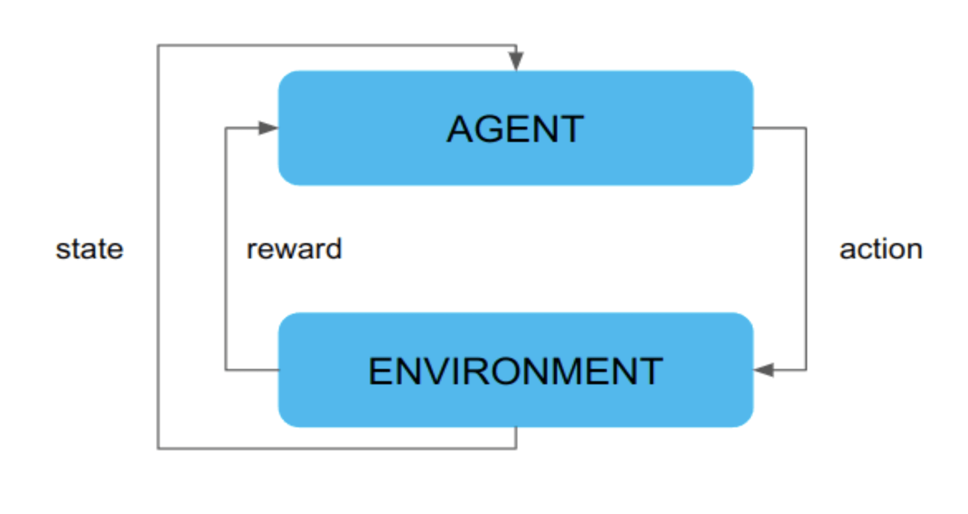
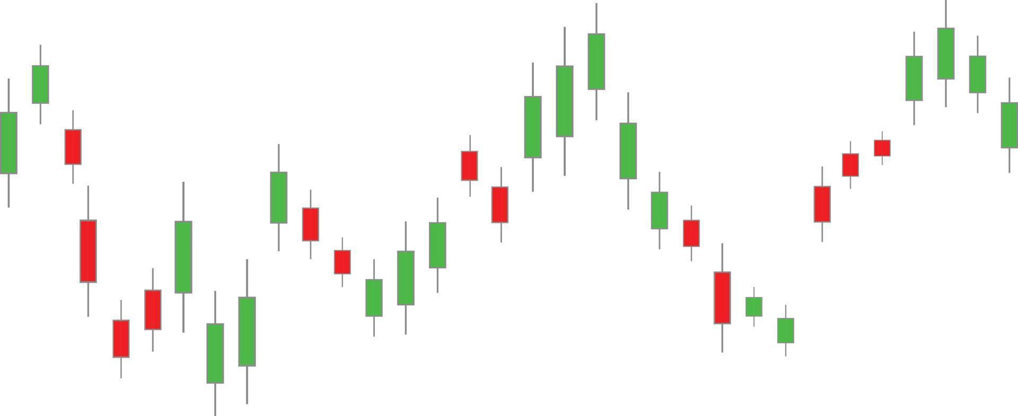
Reinforcement Learning
Goal-Oriented
Feedback Driven
Real World Uses
Reinforcement Learning focuses on improving cumulative rewards while training. As the agent improves, the reward values increase exponentially
Reinforcement Learning agents have an action space that includes all of choices it could make. It decides on which decision to make through learning done on previous actions and their results
There are many uses for reinforcement learning among vast industries. Some examples include NLP, autonomous vehicles, financial trading, or personalized recommending.
Notes:
Chris

Slide 7
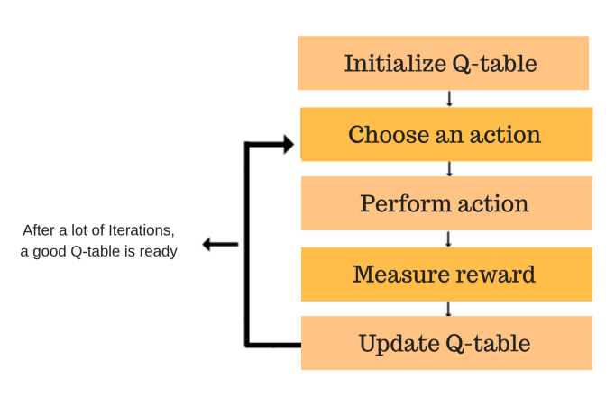
Traditional Q-Learning
Overview of traditional Q-Learning algorithm
Maintains a table of state-action value estimates (Q-values) and a list of action rewards
Updates Q-values using temporal difference learning or Bellman’s equation
Selects actions using an exploration-exploitation strategy (e.g. epsilon-greedy)
Limitations of traditional Q-Learning
Unable to scale to large state spaces due to the curse of dimensionality
Requires discretization of the state and action spaces
May struggle to generalize to unseen states
Notes:
Markus

Slide 8
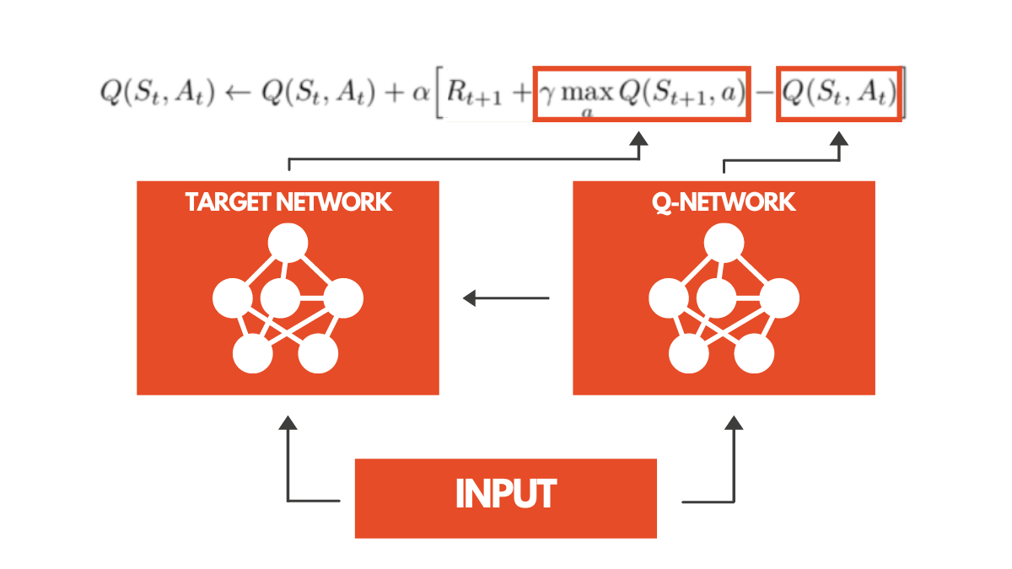
Deep Q-Learning
Deep Q-Learning Algorithm
Utilizes Deep Neural Networks as function approximation of aforementioned Q table
Takes advantage of NNs but is not a model itself
Notes:
Markus

Slide 9
Technical Approach: Deep Q-Learning
Core Components
Deep Neural Networks
ε-Greedy Action Selection
Environment
Gymnasium
Open-Source Tetris Game
PyTorch for Deep Learning
Key Data Metrics
Loss between predicted and actual Q-values
Reward, per episode and cumulative
Notes:
Markus

Slide 10
Project Timeline
Setup Phase
VM Setup
Environment Configuration
Initial Testing
Research
Development Phase
Implement DQN
Training Algorithms
Experiment with different network architectures
Debug issues
Final Phase
Multiple Training Runs
Tune parameters
Data Analysis
Results Compilation
Notes:
Emilio

Slide 11
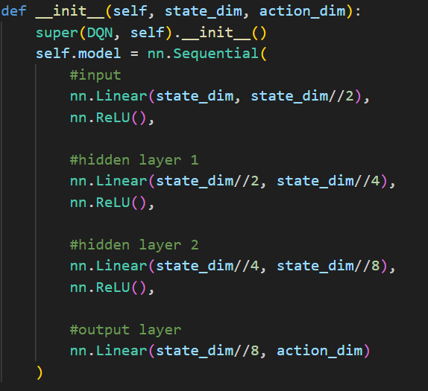
DeepQNetwork.py
DQN Layering
Implementation
Our Deep Q-Learning network follows a FCNN architecture. Meaning it processes data using three fully connected neural layers.
This architecture works for Tetris because of its ability to comprehend and focus on a small amount of metrics, like height of stacks, total points, and lines cleared.
The network inputs a dimension of 944 and eventually outputs 8 Q-values from which the model chooses from when decision-making.
The network uses a ReLu function for activation. Since it helps simplify the more complex aspects of tetris and is computationally efficient.
Notes:
Michael, fully connected neural network, Rectified Linear Unit activation function

Slide 12
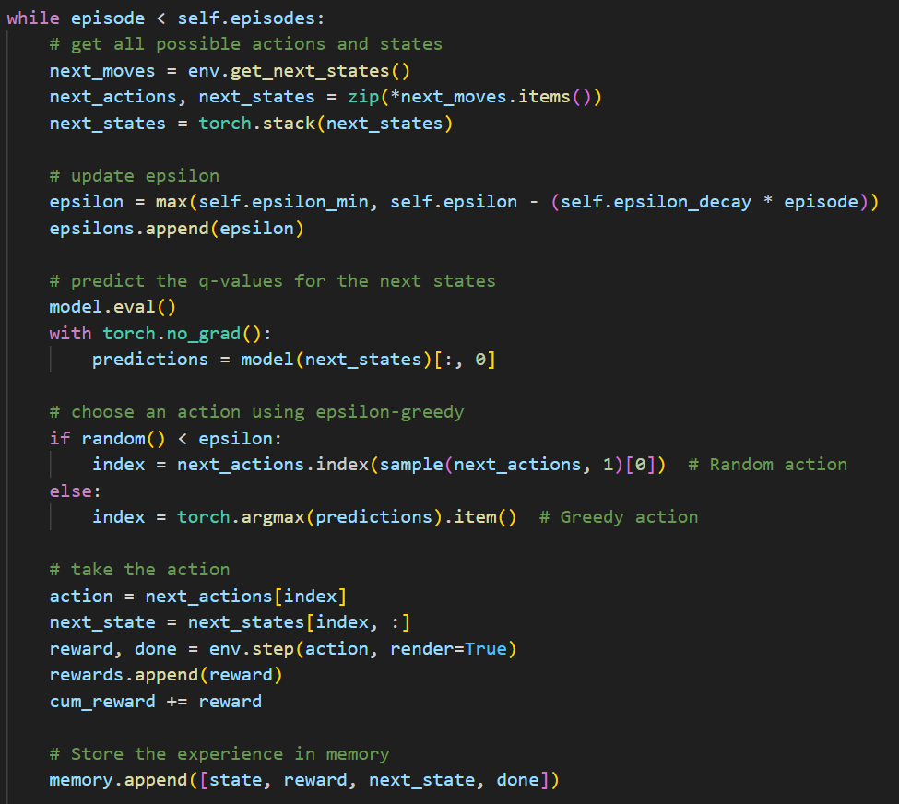
main.py
Training
Epsilon-Greedy Exploration
The model balances and tries exploration (random actions) and exploitation (Q-value based actions) using epsilon-greedy decay.
Batch Training
The most recent samples from memory are used to update the model by minimizing the difference between predicted and target Q-values through training.
Buffers and Run Time
Our agent trained for a set amount of games. We set this number to be 4000 attempts. The agent uses the first 600 episodes as a buffer to collect data and begins training after.
Notes:
Michael

Slide 13
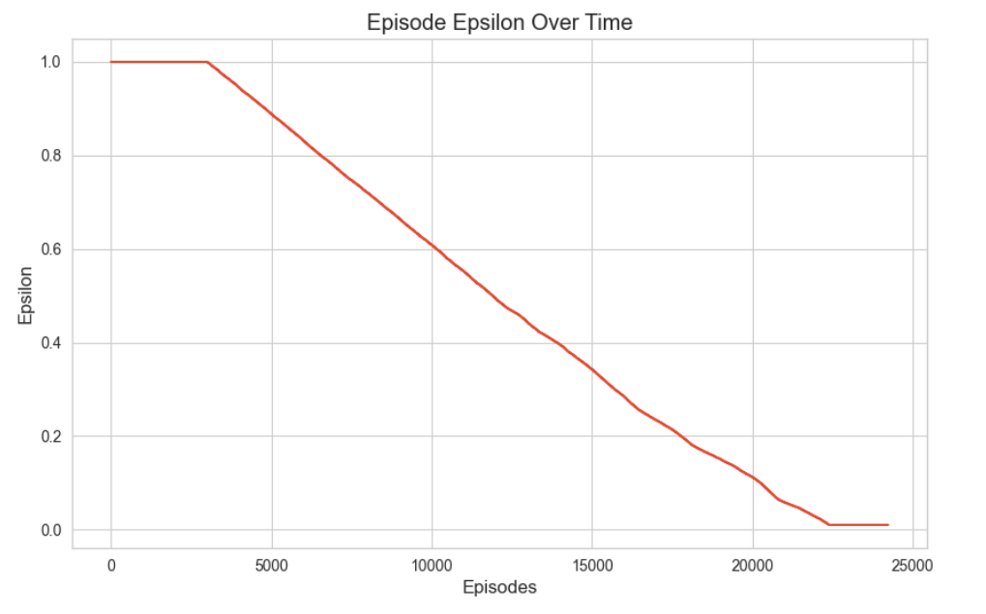
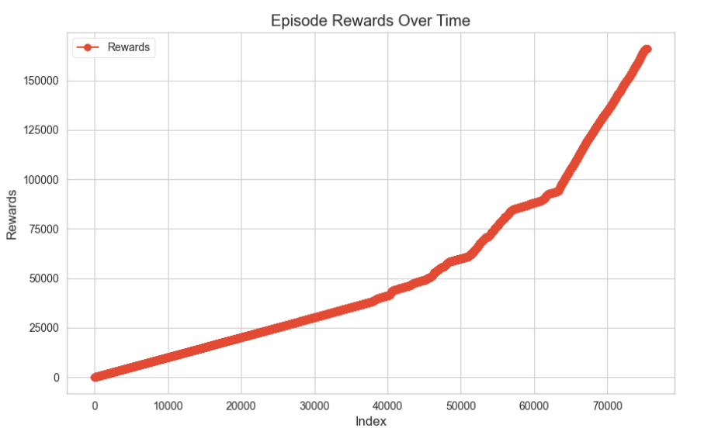
Training Progress and Results
Challenges During Training
After an initial lack of progress, we experimented with tuning hyperparameters like batch sizes, learning rate, epsilon-decay, memory size, and length to limited success.
Environment Experiments
The reward system of the Tetris gymnasium environment was preventing successful training, the model was switched to a custom reinforcement learning Tetris program.
Training Success
Eventually after tuning and structural changes, we were able to successfully train the model to play Tetris. The model’s record being over 16000 points and 800 lines cleared and took only ~2200 episodes.
Notes:
Michael

Slide 14
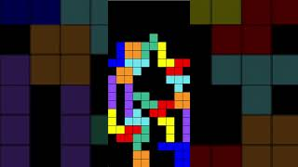
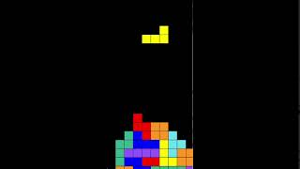
Project Results
Before Training
After Training
Notes:
Michael

Slide 15
Analysis
Alignment with Goal:
Our base agent was able to learn an effective Tetris playing strategy and achieve higher scores than a random agent or average human
Comparison of reward functions is in-progress
Future Improvements: Explore alternative network architectures, hyperparameter tuning, and incorporation of more advanced RL techniques like double DQN or dueling DQN
Notes:
Emilio

Slide 16
Conclusion
Key Takeaways:
Demonstrated the effectiveness of deep reinforcement learning for solving complex sequential decision-making problems
Learned that careful feature engineering and network design are crucial for achieving good performance
Next Steps:
Complete study of reward functions
Adapting the model to different games/applications.
Implement early stopping to prevent overfitting.
Record state, action, and rewards for others’ future study
Notes:
Emilio

Slide 17
Q&A
?

